Slide 1
EMPLOYEE SALARY PREDICTION USING ML ALGORITHMS
CAPSTONE PROJECT
Presented By:
Student Name – Girish Subodh Indurkar
College – Priyadarshini College Of Engineering, Nagpur
Internship Batch - AICTE B2 June 2025
SkillsBuild Registered Email ID – girishindurkar3@gmail.com
Department – Computer Science Engineering
AICTE ID – STU6837481d5d12d1748453405

Slide 2
OUTLINE
Problem Statement
System Development Approach
Algorithm & Deployment (Step by Step Procedure)
Result
Conclusion
Future Scope
References

Slide 3
Problem Statement
The goal of this project is to predict whether an employee earns more than 50K annually based on their demographic and professional information.
The dataset contains features like age, education, occupation, hours worked per week, and more.
There are significant class imbalances in income levels, which creates a need for efficient classification models.
Accurate salary classification can be used in HR systems for early analysis, filtering, and candidate screening.
We aim to automate this task using machine learning algorithms.

Slide 4
System Approach
System Requirements:
  Python 3.8+
  Google Colab or local Jupyter Notebook
  Internet access for installing libraries
Libraries Used:
  pandas, numpy for data handling
  sklearn for machine learning
  matplotlib, seaborn for visualization
  joblib for model saving
  streamlit, gradio for UI development
Development Tools:
  Google Colab (for training and testing)
  GitHub (for version control and project hosting)

Slide 5
Algorithm & Deployment
Load the dataset (adult.csv) into Colab
Preprocess the data (handle missing values, label encode categorical features)
Split the data into training and testing sets
Trained two models:
  Logistic Regression
  Random Forest Classifier
Evaluate both models and compare accuracy
Save the best model using joblib
Develop a Streamlit and Gradio interface for predictions
Deploy the Streamlit app via Streamlit Cloud or ngrok (Colab)
Test batch predictions using uploaded CSVs
Upload code and documentation to GitHub

Slide 6
Result
The Random Forest model gave higher accuracy (~87%) than Logistic Regression (~83%).
Streamlit UI successfully predict salary class based on user inputs.
Batch prediction via CSV also functions accurately.
GitHub Link:
https://github.com/girish-indurkar/Employee-Salary-Prediction-Model.git

Slide 7
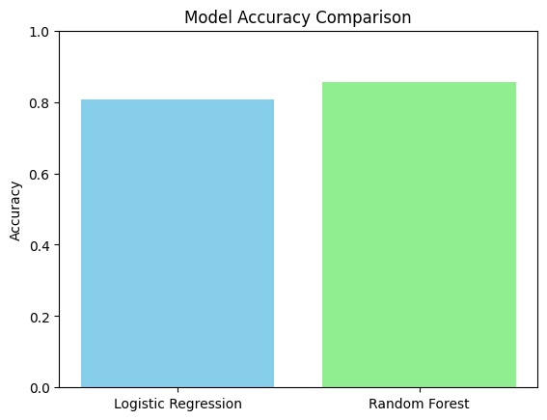
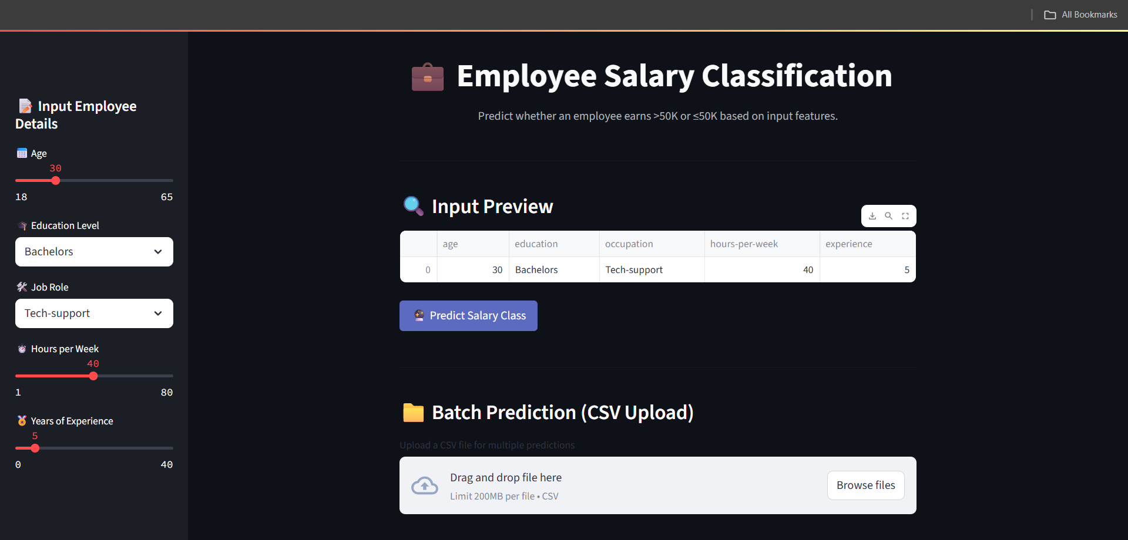

Slide 8
Conclusion
The project successfully predicts employee salary class using machine learning.
Random Forest outperformed Logistic Regression in terms of accuracy and robustness.
Both Streamlit and Gradio interfaces made the model accessible to non-technical users.
Minor challenges included data cleaning and label encoding for UI inputs.
Future improvements may include using deep learning or more advanced ensemble models.

Slide 9
Future scope(Optional)
The project successfully predicts employee salary class using machine learning.
Random Forest outperformed Logistic Regression in terms of accuracy and robustness.
Both Streamlit and Gradio interfaces made the model accessible to non-technical users.
Minor challenges included data cleaning and label encoding for UI inputs.
Future improvements may include using deep learning or more advanced ensemble models.

Slide 10
References
UCI Adult Income Dataset
Scikit-learn Documentation: https://scikit-learn.org
Streamlit Docs: https://docs.streamlit.io
Gradio Docs: https://www.gradio.app
Various online tutorials and GitHub examples for deployment

Slide 11
THANK YOU

